Slide 1
Famous Robots in History
Tom Bickford
Maine Robotics
© 2012

Slide 2
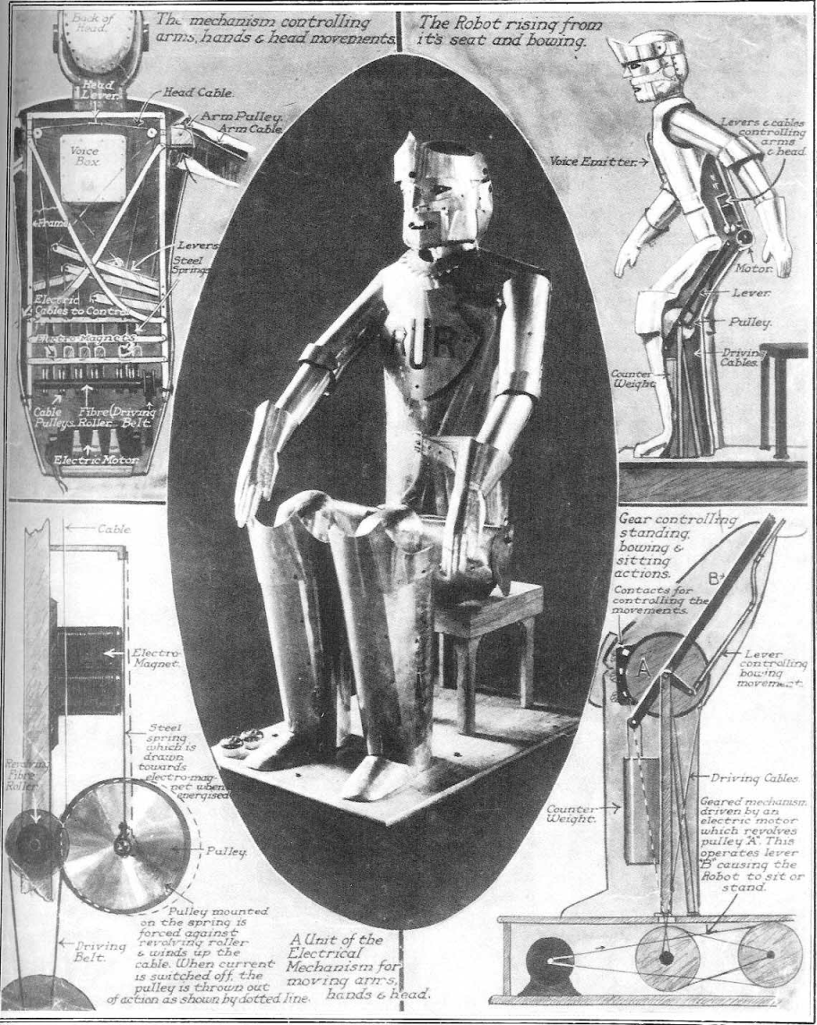
Where it came from:
KAREL CAPEK, 1920 A Czechslovakian playwright, wrote Rossum’s Universal Robots about mechanical slaves that would do work for their human owners.

Slide 3
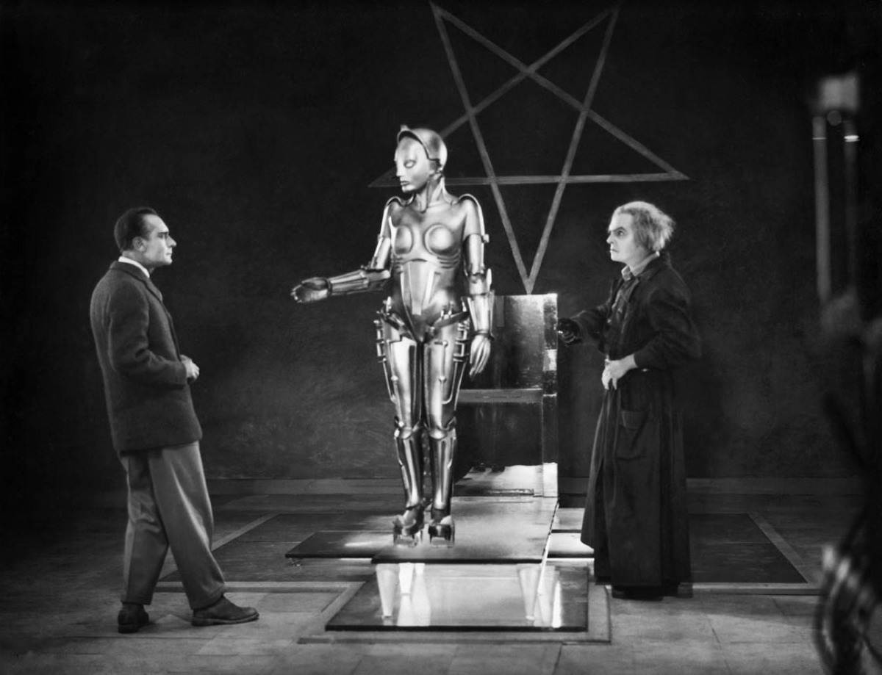
Robots make it to Hollywood:
Metropolis, filmed from 1925 to 1926 in Germany and released in 1927. Re-released in the United States in 1929 as a shorter version.

Slide 4
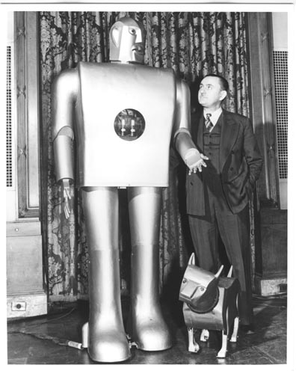
Electro and Sparky:
General Electric exhibited these two robots at the 1939 World’s Fair
They were the first such creations that actually utilized electric motors to move and behave

Slide 5
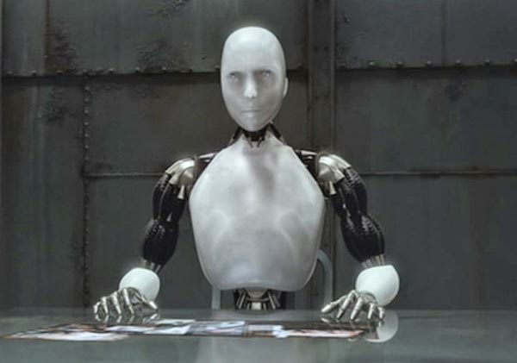
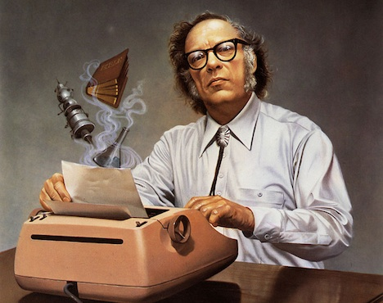
Isaac Asimov (1920-1992):
Science fiction writer (over 500 books)
Introduced the “3 Laws of Robotics” in 1941
Author of the famed story “I Robot”
Helped move robots and robotics into the main stream culture

Slide 6
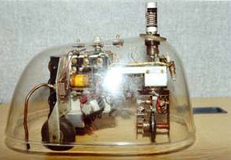
First Autonomous Robot(1948):
Grey Walter built Elmer and Elise, the first two autonomous robots in the world
These could move around on their own power
Named Turtles after a character in Alice’s Wonderland

Slide 7
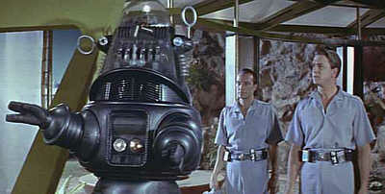
Robbie the Robot (1956):
From the movie Forbidden Planet

Slide 8
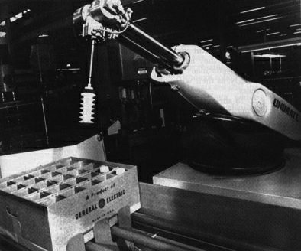
Unimate (1961):
First industrial robot starts working on production lines
Weighed 4,000 pounds
Instructions were stored on a magnetic drum (early analog/digital computer)

Slide 9
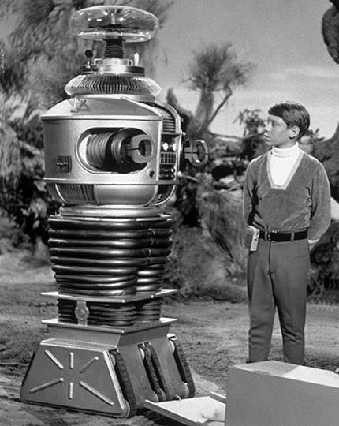
B-9, Class M-3 General Utility Non-Theorizing Environmental Control Robot:
Famed robot from the Lost in Space series
1965
“Danger Will Robinson, Danger!!”

Slide 10
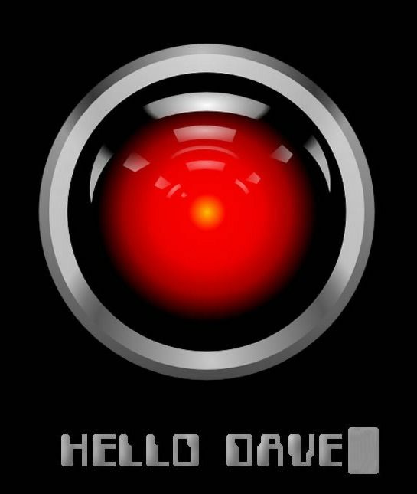
HAL 9000 (1968):
From the movie “2001 a Space Odyssey” HAL was the computer that ran the ship
Since it had both the computer and the ability to act it was really a robot
Heuristic ALgorithmic Computer

Slide 11
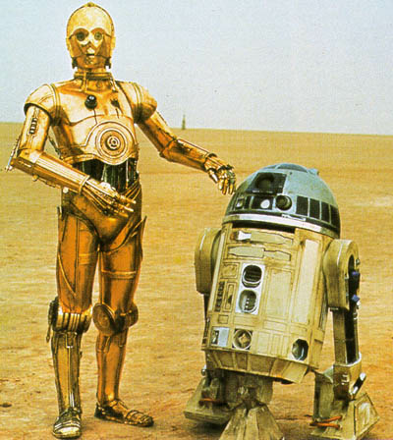
Star Wars (1977):
C3P0 and R2D2 arrive on the scene and not only affect sales of the movie, but cause a boost in worldwide robot demand… Unfortunately, robot technology couldn’t yet live up to the hype

Slide 12
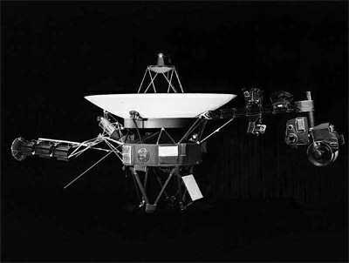
Voyager 1 (1979):
Travelling through space for the last 33 years
Has 11 instrument packages that work together with a control system to send information back to Earth

Slide 13
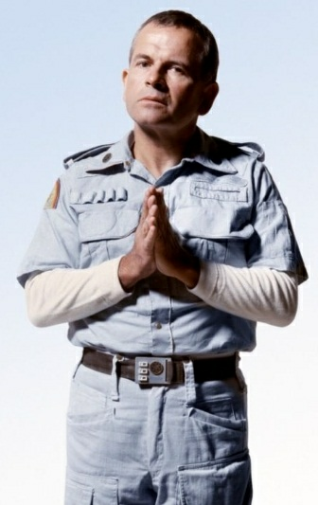
Ash (android - 1979):
Science officer aboard the space craft from the movie Alien
Humanoid character that was part machine part living organism

Slide 14
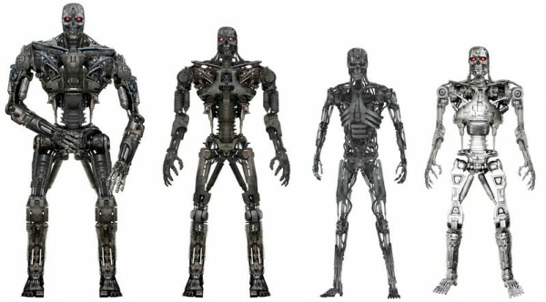
The Terminator (1984):
Robots enter the horror realm big time

Slide 15
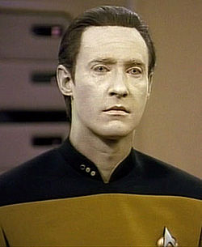
Data from Star Trek NG (1987):
Cyborg from the Star Trek Next Generation series
One of a kind learning computer and android body

Slide 16
What makes a robot?

Slide 17
Computer Agency
Can the machine process information and perform decision logic
Physical Agency
Can the machine interact with it’s environment?
Yes, it’s a Robot!

Slide 18
All the parts that are needed:
Physical body
Motors
Power supply
Computer
Memory
Processor
Speed
Memory transfer rate
Sensors
Vision
Hearing
Touch
Internal
Balance
Program
Decision logic
Artificial Intelligence

Slide 19
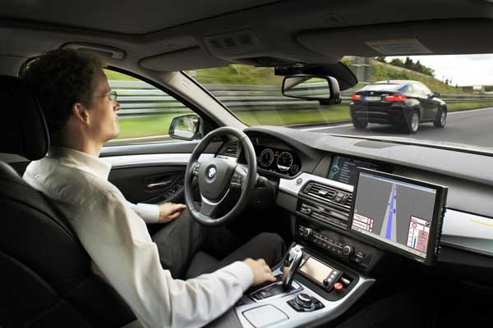
Some examples:
Self driving cars Like the Google Taxis
Body ✓
Computer ✓
Sensors ✓
Programming ✓
Autonomous ✓

Slide 20
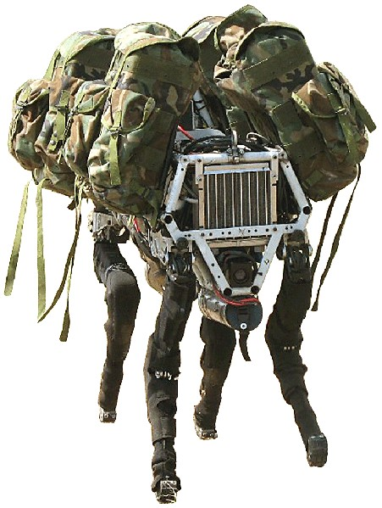
Some examples:
Boston Dynamics “Big Dog”
Body ✓
Computer ✓
Sensors ✓
Programming ✓
Autonomous ?

Slide 21
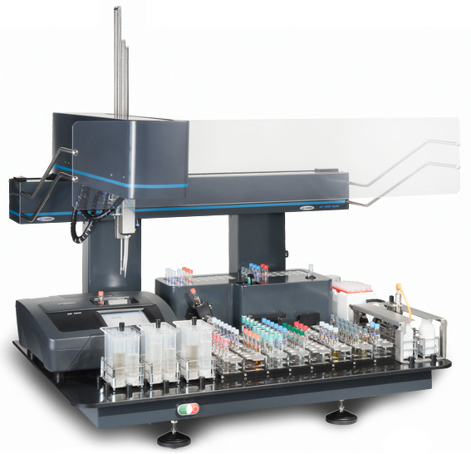
Some examples:
Laboratory robot, can do repetitive chores
Body ✓
Computer ✓
Sensors ✓
Programming ✓
Autonomous ✓

Slide 22
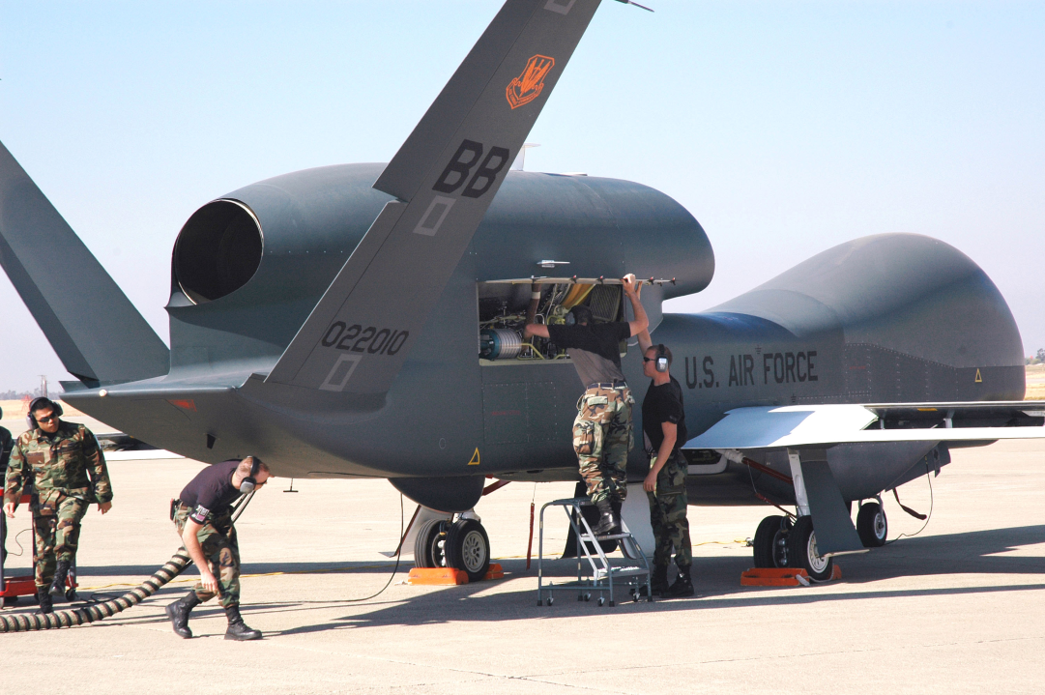
Some examples:
RQ-4 Global Hawk Reconnaissance Drone
Body ✓
Computer ✓
Sensors ✓
Programming ✓
Autonomous ?

