Slide 1
Famous woman scientists
Presented by:
Maine Robotics
Serving Maine youth since 2004

Slide 2
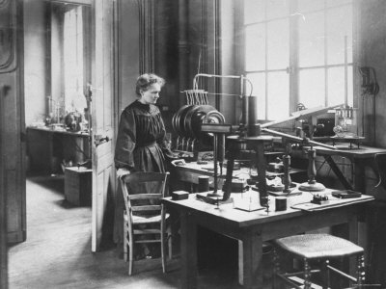
Marie curie
1867-1934
Known for:
first well-known woman scientist in the modern world
"Mother of Modern Physics" -- pioneer in research about radioactivity, a word she coined
First woman awarded a Ph.D. in research science in Europe, first woman professor at the Sorbonne
Discovered and isolated polonium and radium, and established the nature of radiation and beta rays
First woman to receive the Nobel Prize and first person to receive two Nobel Prizes (1903 for physics, 1911 for chemistry.

Slide 3
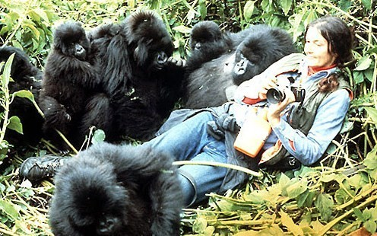
Dian Fossey
January 16, 1932 - December 26, 1985
Occupation: primatologist, scientist
Known for: study of mountain gorillas, work to preserve habitat for gorillas
Work History:
Dian Fossey studied as a preveterinary student in her undergraduate work
Seven years as director of occupational therapy in a Louisville, Kentucky hospital.
Dian Fossey developed an interest in mountain gorillas, and wanted to see them in their natural habitat.
Met with Mary and Louis Leakey before traveling to Zaire.
Visited Jane Goodall to learn from her, and then made her way to Zaire and the home of the mountain gorillas.
Dian Fossey earned the trust of the gorillas, but human beings were another matter. She was taken into custody in Zaire, escaped to Uganda, and moved to Rwanda to continue her work.
By techniques she developed, especially imitation of the gorilla behavior, she was again accepted as an observer by a group of mountain gorillas there.
From 1970-1974, Fossey went to England to get her doctorate at Cambridge University, in zoology. Her dissertation summarized her work thus far with the gorillas.
1980 Wrote the book “Gorillas in the Mist”, later made into a motio

Slide 4
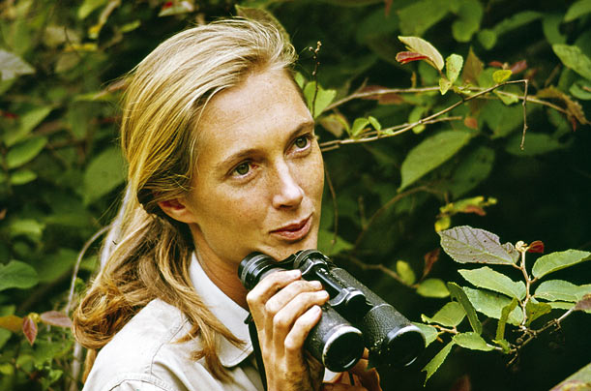
Jane goodall
1934-
Occupation: primatologist, scientist, chimpanzee researcher and observer, environmentalist
Known for her work with chimpanzees at Gombe Stream Reserve
Received a Ph.D. in Ethology from Cambridge University. Jane had neither a bachelor or masters degree but was awarded her doctorate in 1965
Originally brought to Africa to work with Louis Leakey, Jane Goodall began her work with chimpanzees in the Gombe Stream Reserve in 1970. By close observation, she documented the social organization of chimps in the wild, including their social nature, their tool-making, their occasional systematic killing of one another, their hierarchy and their social development.

Slide 5
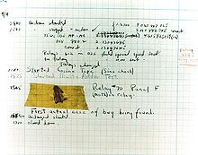
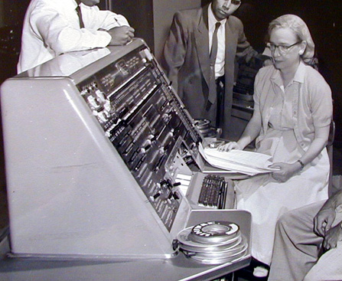
Grace hopper
1906-1992
Earned bachelors in mathematics and physics from Vassar College
Earned a masters and doctorate from Yale University in mathematics
Joined the naval reserves in 1943 and graduated from the Midshipman’s school in 1944 top of her class.
Started her naval career as a Lieutenant, junior grade in 1944 and retired 42 years later as a rear admiral
Her specialty during most of those years was computing and the science of computers and programming.
One of the original authors of the COBOL programming language
While she was working on a Mark II Computer at Harvard University in 1947, her associates discovered a moth stuck in a relay and thereby preventing operation, whereupon she remarked that they were "debugging" the system.

Slide 6
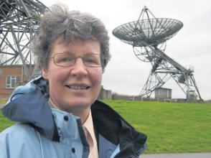
Jocelyn Bell burnell
1943-
Ph.D. from the University of Cambridge, 1969
Astrophysicist who helped discover the first radio pulsars using an early radio telescope; earning her supervisors the Nobel prize.
Served as president of the Royal Astronomical Society and the Institute of Physics.
Faculty at Oxford, Princeton, University of Bath, and the Open University

Slide 7
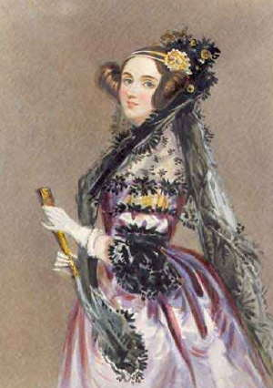
Ada Lovelace
1815-1852
Known for her work on Charles Babbage's early mechanical general-purpose computer, the analytical engine.
Her notes on the engine include what is recognized as the first algorithm intended to be processed by a machine; as such she is regarded as the world's first computer programmer.
Self taught mathematician, she rose to be a significant force in Britain’s mathematical society, even given her young age.
The ADA programming language was named after her

Slide 8
Women make great scientists
No ifs,
No ands,
Or buts…
Women have all the same abilities to excel in mathematics, medicine, astronomy, chemistry, wildlife, physics, engineering

